Slide 1



SnapJam
Fall 2024 - Presentation
PROJECT PROPOSAL
Pabak Dev
20220204005
Rafy Bhuiyan
20220204023

Slide 2
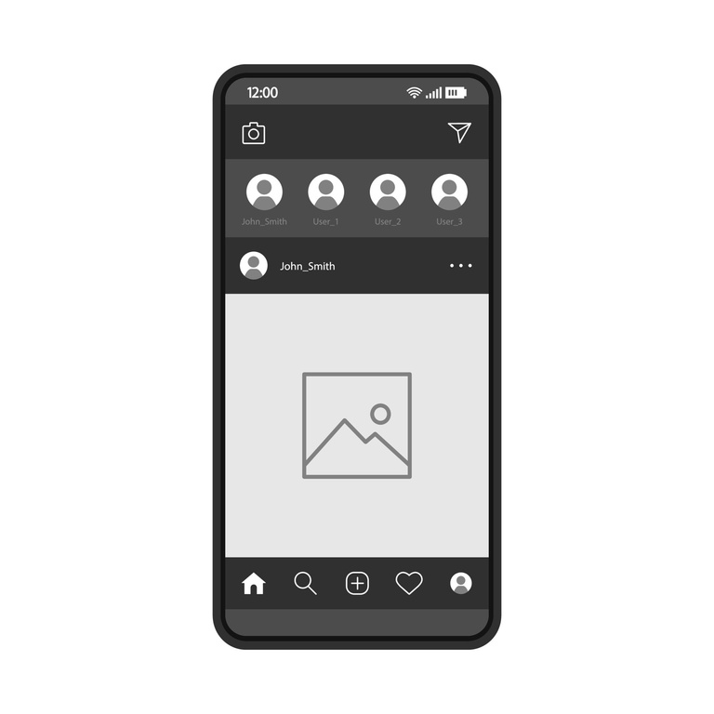
Content
01
Overview
02
About
03
Checkpoints
04
Future goals
05
Our Team

Slide 3





Overview
SnapJam a social media platform to share your pictures and thoughts online.
01
Share
Connect
02
03
Chat
Express
04

Slide 4




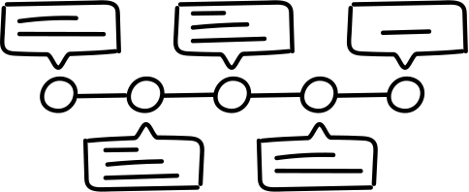
ABOUT / CONTENT
SnapJam is a social media platform, which prioritizes simplicity above all.
Profile
Chatting
Timeline
Profile is a media face for each and every users. They can post in their timeline and customize their timeline with posts they share.
Users can communicate with each other in the chat section. This chats are the media of private contact between the two users.
A common page where all the shared posts from all the users connected with each other will be seen all together.

Slide 5





Submission
Bugfixing and more
Checkpoint 3
Chatting and customization
CHECKPOINTS
Checkpoint 2
Posting and timelines
Checkpoint 1
Login and authentication

Slide 6






Future goals
we have plans to add some new features like voice chat, story sharing, video sharing, game section and a independent marketplace.
We have also plans to bring new security and feature updates and bug fixes.

Slide 7




Our Team
Rafy Bhuiyan
20220204023
Pabak Dev
20220204005
Manager

Slide 8

THANK YOU

